Slide 1


Project Mcnulty: Predicting default risk of loans
Meena Anantha Padmanabhan

Slide 2


Problem Statement
Approach
EDA
Model results
Application
Background
Home Credit offers loans to people with little or no credit history
Problem statement
What is the probability that a customer defaults on a loan?
Founded in 1997; operates in 14 countries
15 million active customers as of 2016
Launched in USA in 2015
Notes:
Important problem in the banking space

Slide 3
Problem Statement
Approach
EDA
Model results
Application
Understanding the lifecycle of a loan helps in determining modeling approach
Lifecyle of a loan
Application
Approved
Current on Loan term
Fully Paid
Rejected
Delinquent
Charge-off/Default
Recovery /Settlement
Model Building approach
History
Performance window
History
Observation point

Slide 4
Problem Statement
Approach
EDA
Model results
Application
Three categories of features were used for model building
Ranking of the region where customer lives,
# Children, Whether customer owns a car, owns property, age of the car, Occupation, Annual income, Date of last employment change, # of Family members, Housing type, Family Status
Number of Bureau inquiries x months before the application
Loan amount, Annuity amount, Credit Term, Price of goods for which the loan is given,
Days since KYC was updated, Types of phone number provided, Date of last phone # change

Slide 5
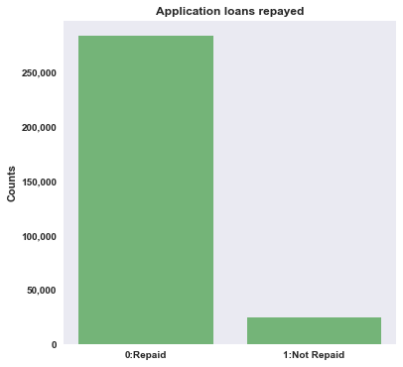
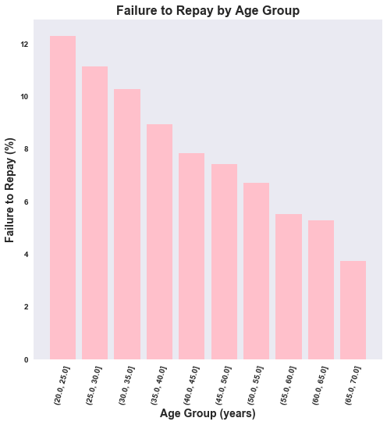
Problem Statement
Approach
EDA
Model results
Application
The dataset indicates that the target variable is imbalanced
Target variable
Notes:
Logistic regression – precision is low – which means you are predicting a lot of people who don’t default as defaulters….(why?)

Slide 6
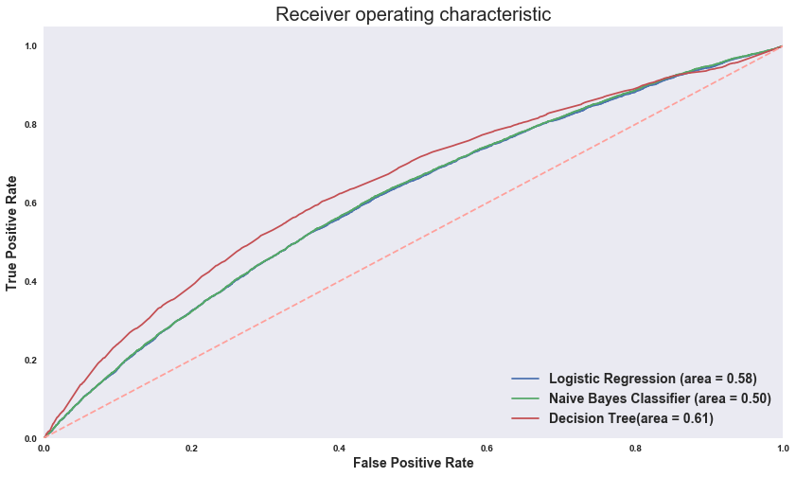
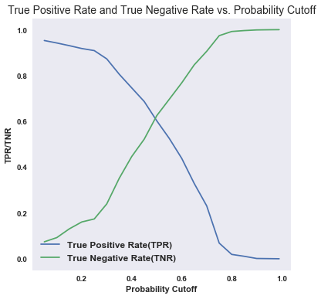
Problem Statement
Approach
EDA
Model results
Application
Decision Tree outperforms Logistic Regression and Naïve Bayes classifier
Notes:
Assuming that we want to maximize both true positives and true negatives, the cutoff is where the two rates meet. Which is at 0.5

Slide 7
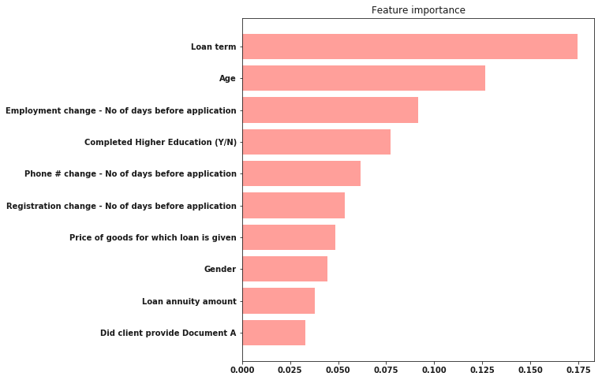
Problem Statement
Approach
EDA
Model results
Application
The top 10 features based on Decision Tree classifier
Notes:
Logistic regression – precision is low – which means you are predicting a lot of people who don’t default as defaulters….(why?)

Slide 8
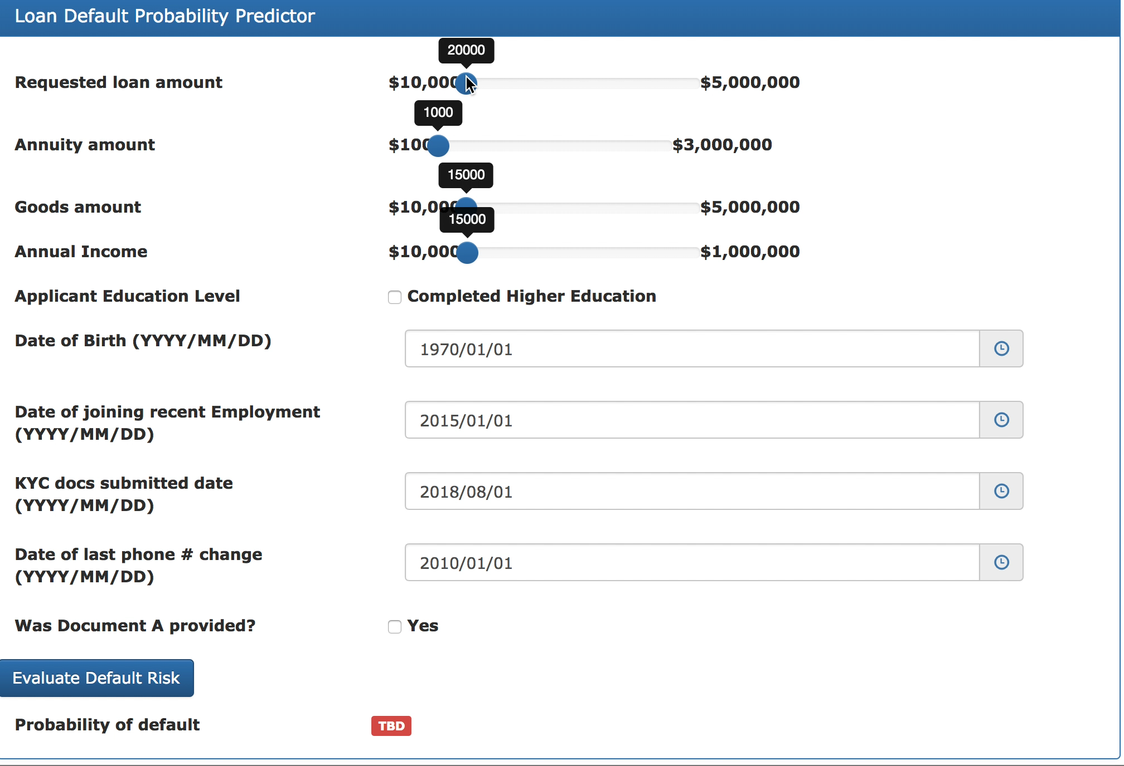
Problem Statement
Approach
EDA
Model results
Application
Notes:
Logistic regression – precision is low – which means you are predicting a lot of people who don’t default as defaulters….(why?)

Slide 9
Thank you

Slide 10
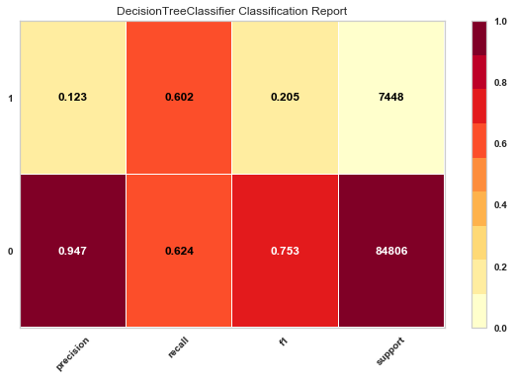
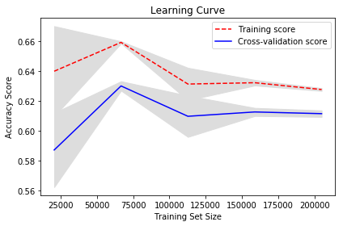
Decision Tree Classifier

